Slide 1
Django in the real world
Susan Ibach
Christopher Harrison

Slide 2
Class based views

Slide 3
Core developer concepts
Creating applications can be repetitive
You do the same things over and over again
It's repetitive
Create this form
Repeat
Create another form
Repeat
Create another form
Repeat

Slide 4
Let's get something straight
Copy and paste is never the answer
Even copying and pasting is repetitive
And of course that's not to mention what happens when something changes

Slide 5
We're not launching rockets here
Use code that's already written
Use automatically generated code

Slide 6
Enter class-based views
Automatically generate view code
Can even automatically generate HTML

Slide 7
Let's take an index page
Basic steps:
Load the data
Call render to display the page

Slide 8
Enter a class based view
Instead of defining a function, define a class and inherit from a View
Django has several built-in views
ListView
DetailView
CreateView
UpdateView
DeleteView
Some HTML is still required
Needs to follow a convention
Object_list.html
Object_detail.html
Object_form.html

Slide 9
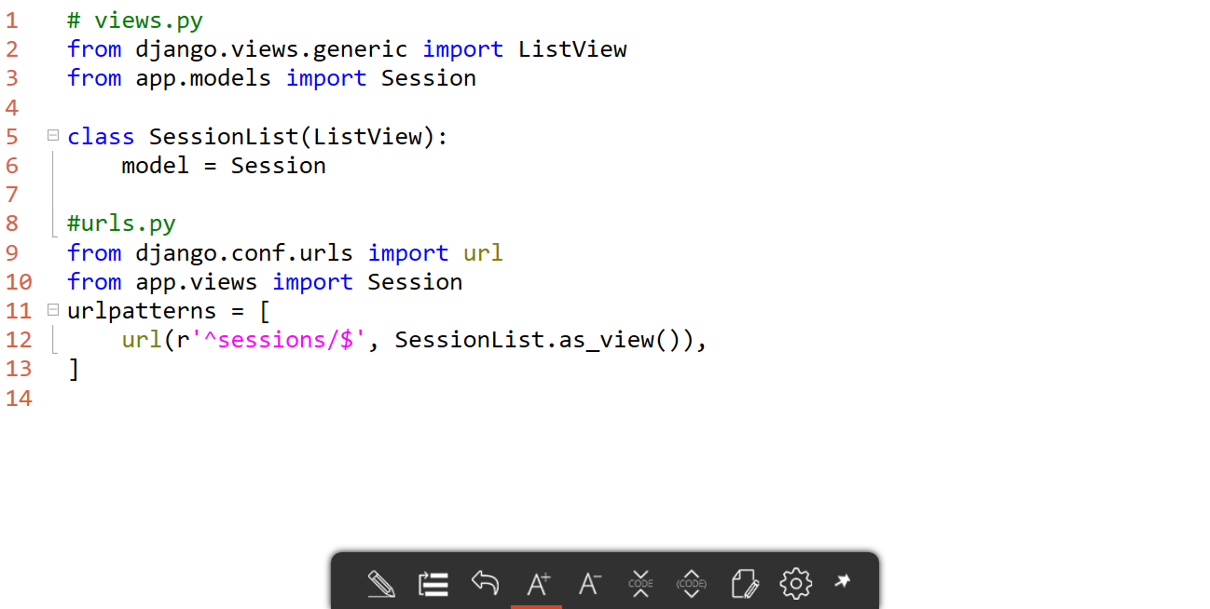
ListView

Slide 10
Displaying data with class-based views

Slide 11
Form based views

Slide 12
Creating forms can be tedious
Generating the same HTML over and over again
Updating forms as the model changes
Agile nightmare
Django offers the ability to automatically create forms
If you are using models, Django can automatically create the form
If you want to customize the form by using a form model, you can still do that

Slide 13
Built-in form views
Django offers built-in forms for the CUD of CRUD
Create
Update
Delete
You do still need to create the HTML page
Name: Object_form.html
<form action="" method="post">{% csrf_token %}
{{ form.as_p }}
<input type="submit" value="Create" />
</form>

Slide 14
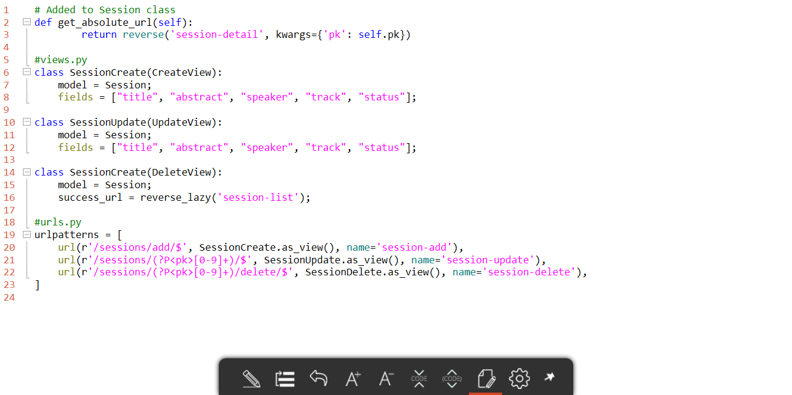
Automatically generated forms

Slide 15
Automatically generated forms

Slide 16
Customizing the form

Slide 17
Automatically generated forms are OK, but...
How do we customize it?
How do we ensure it matches our style?
You could create HTML, but that's tedious

Slide 18
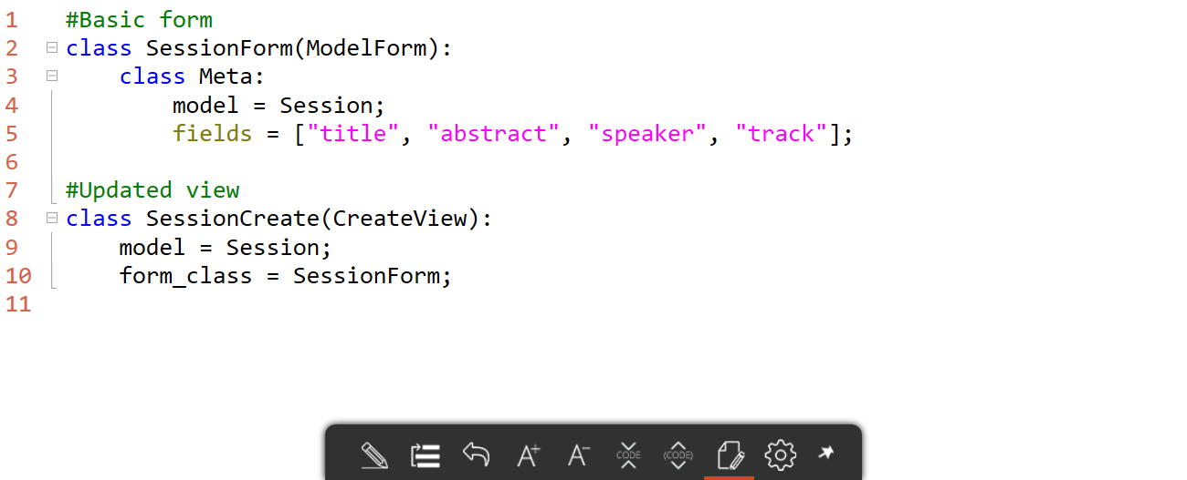
Enter ModelForm
ModelForm is a class that will automatically create a form
But, it's customizable

Slide 19
Customizing the form
What happens if we want the form to use Bootstrap?
Remember, we're not launching rockets
Other people have already solved the problem
One such implementation is crispy-forms
Generates forms using Bootstrap
Simple customization

Slide 20
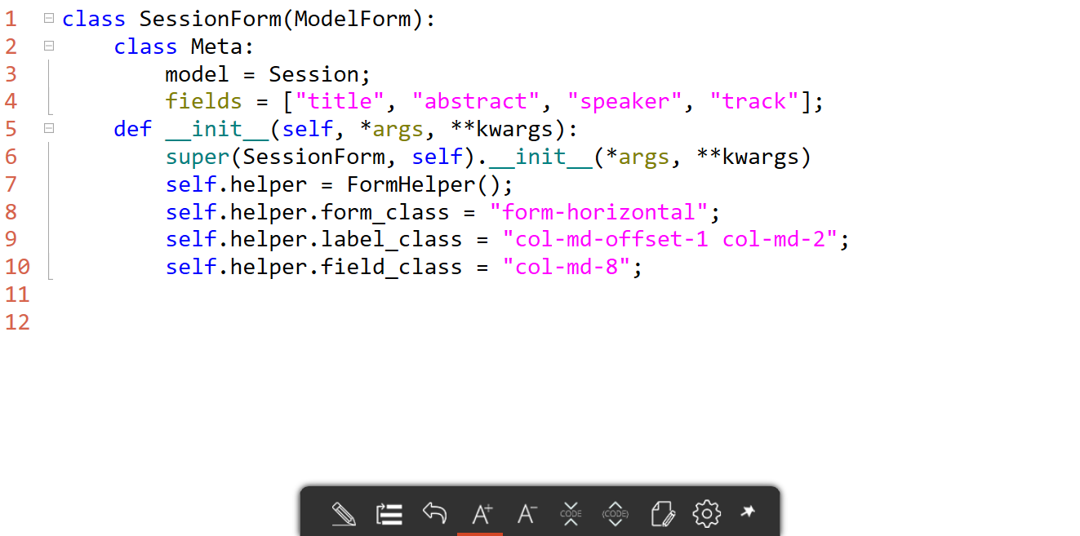
Supporting Bootstrap with crispy-forms

Slide 21
Using Bootstrap forms

Slide 22
Security with class based views

Slide 23
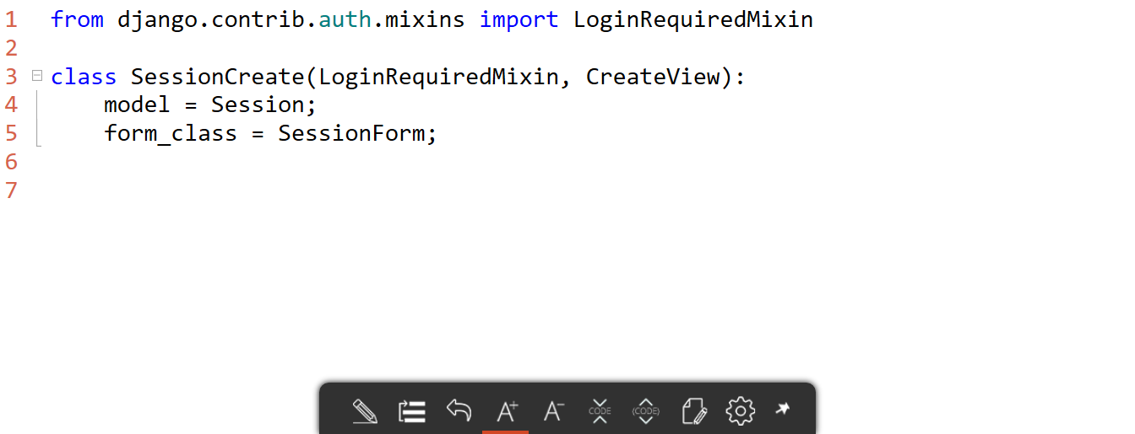
Security with class based views
The decorators won't work
Customize by using mixins

Slide 24
Security with class-based views

Slide 25
Validation

Slide 26
Django handles validation for you
If you're using the class-based views, Django takes care of everything
Set your data types appropriately, and you're done
What happens if you need to customize validation?
Create a validation function

Slide 27
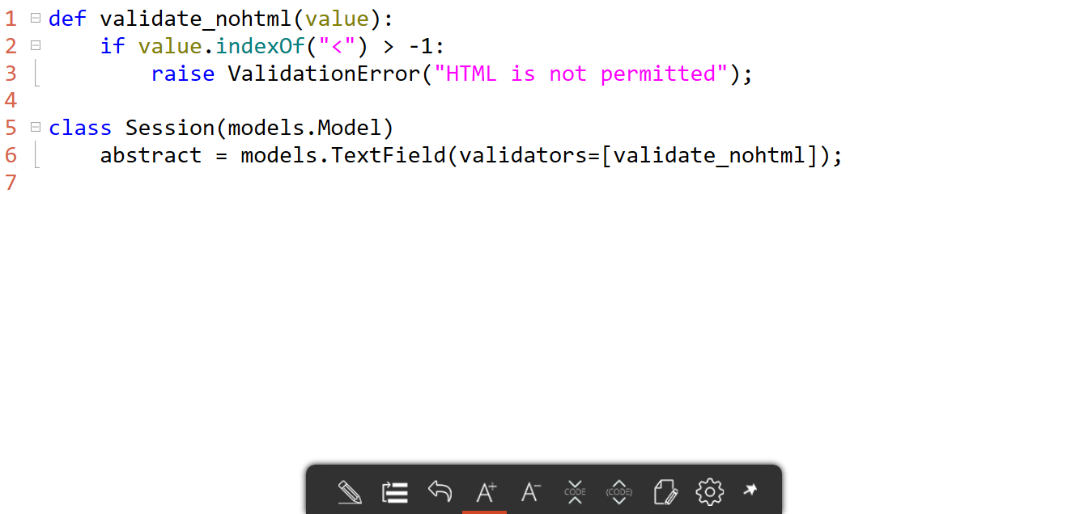
Creating a custom validator

Slide 28
Creating a custom validator

